Slide 1
Identify and Adjust for Non-Response Bias
Benjamin Chu
Biomath 204
3/13/2017

Slide 2
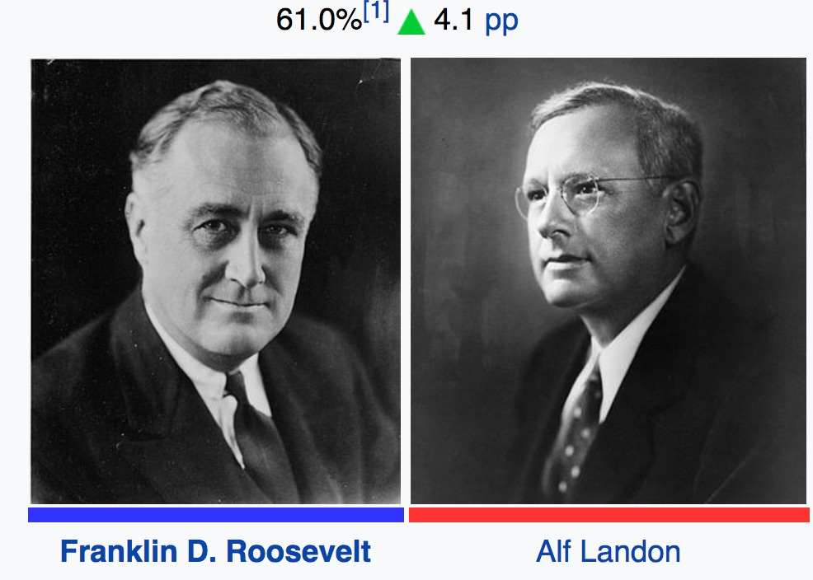
Data analysis: Trash in Trash out
https://en.wikipedia.org/wiki/United_States_presidential_election,_1936

Slide 3
Random Sampling and (unit) Non-Response Bias
Random Sampling:
A subset of individuals (sample) chosen from a larget set (population) to be surveyed
(Unit) Non-response bias:
Error due to a proportion of sample population not responding to poll
When present, no amount of data can negate its effect

Slide 4
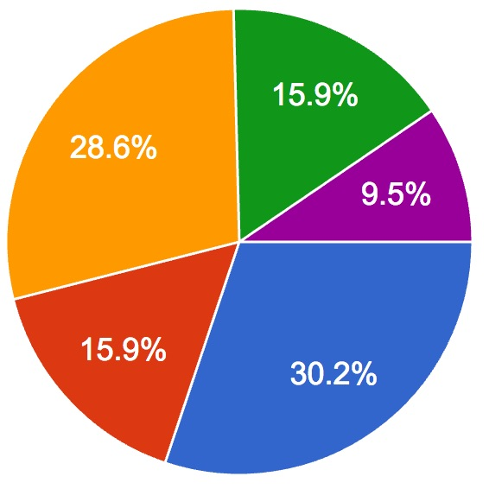
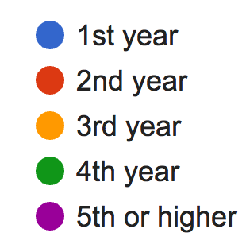
What is NOT non-response
“When particular types of respondents are not reached” - trchome
“Participation is voluntary…” (Wang, 2014)
…...correct but ambiguous.

Slide 5

1991 Race and Politics Survey
Telephone survey with 178 questions
Up to 4 callbacks (identification)
Second survey by mail (adjustment)
http://astro.berkeley.edu/prospective-students/about-berkeley

Slide 6
Callback: Identify non-response bias
Samples may refuse to take survey
Ask subset of non-respondents again.
Assumes “late respondents” ~ non-respondents
Q: How to measure difference between early and late respondents?

Slide 7
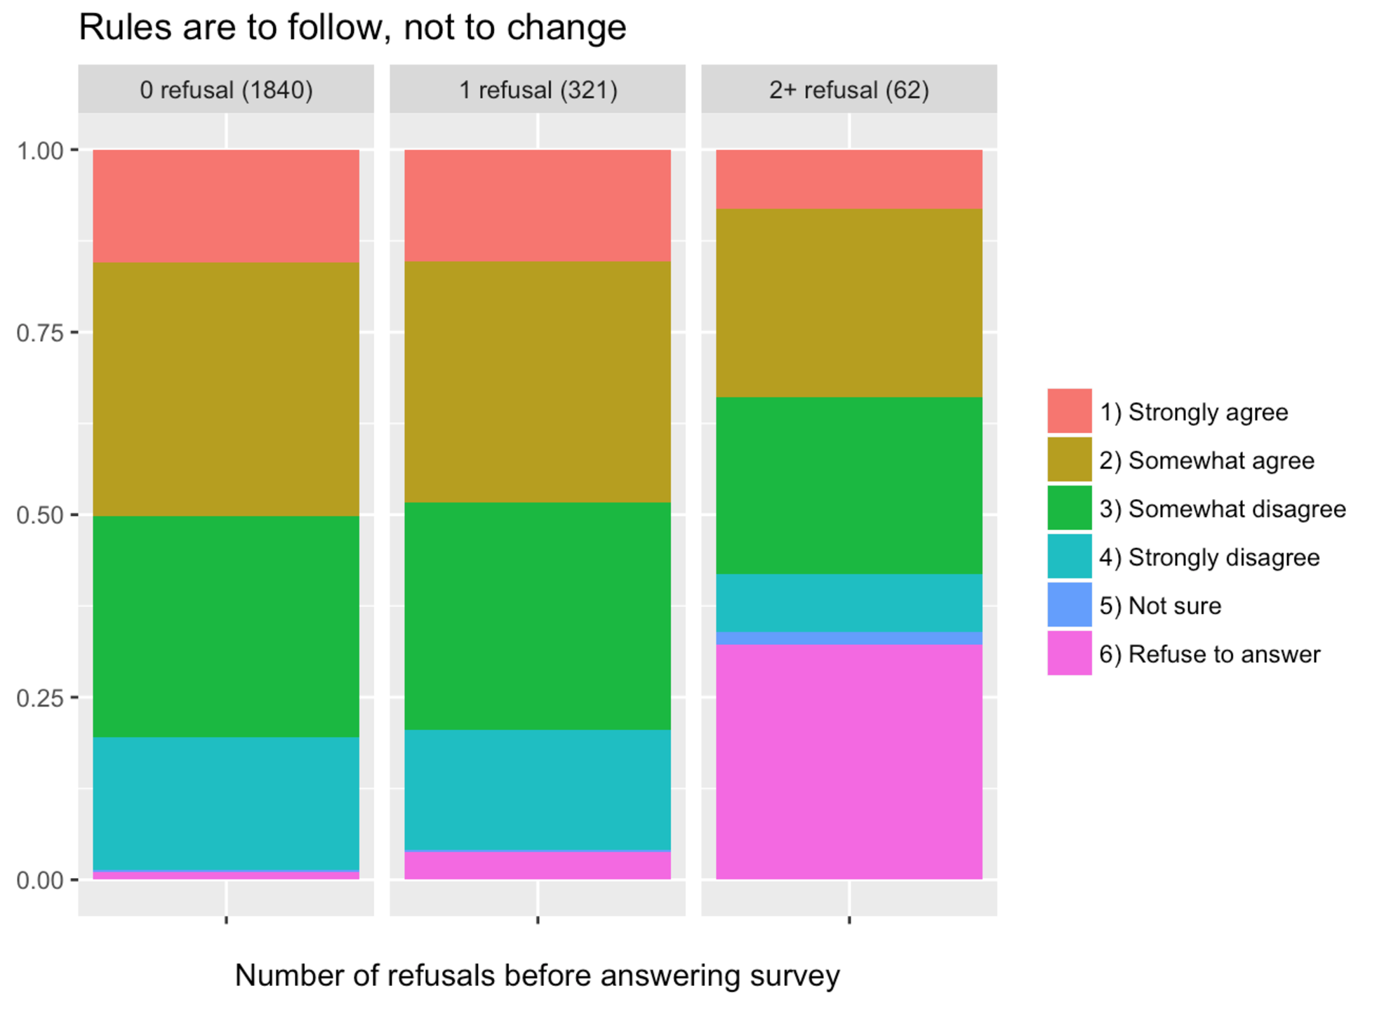
Callback – compare initial and late respondents

Slide 8
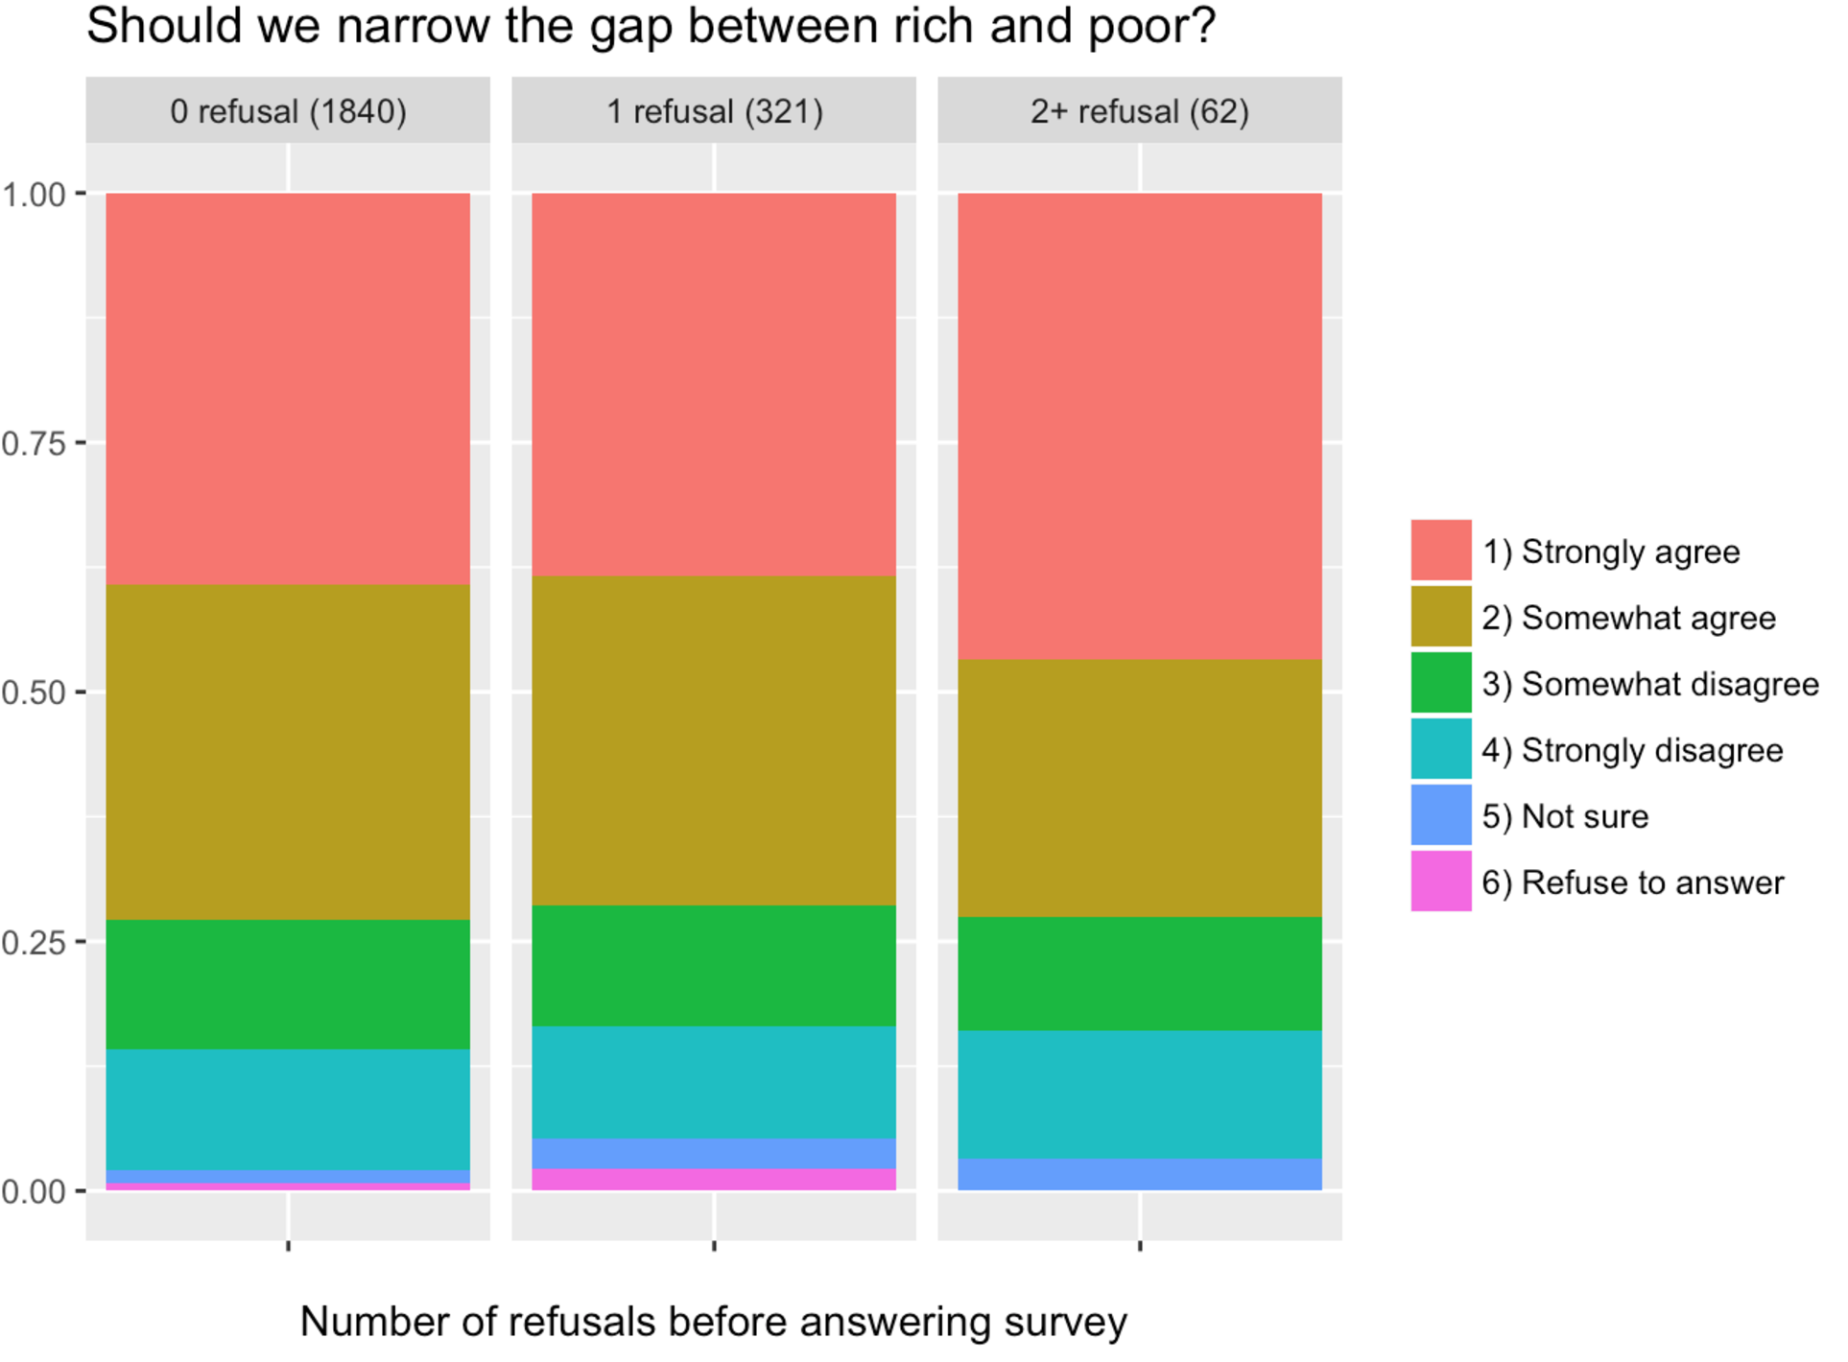
Another callback example

Slide 9

Estimating (true) general opinion
Survey goal: to obtain general opinion on smth
Non-response will skew survey result
Q: how busy?
https://www.buzzfeed.com/matwhitehead/helen-is-all-of-us

Slide 10
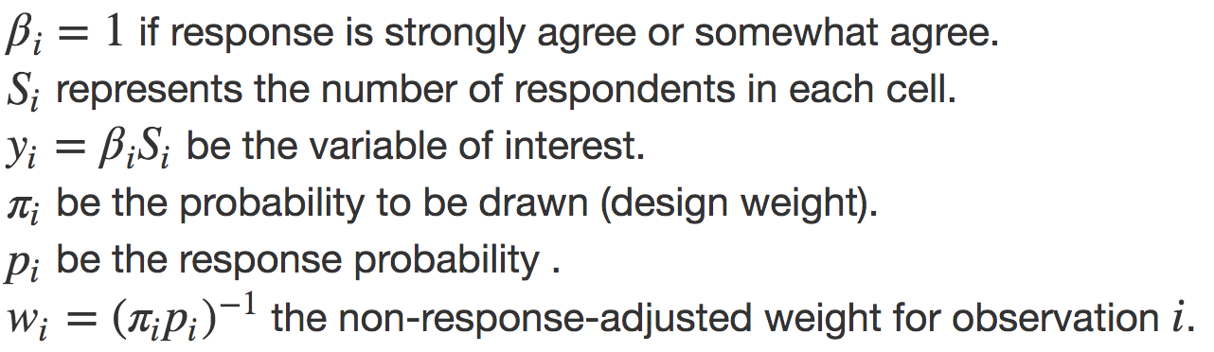
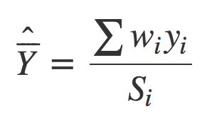
Weighting
Idea:
Divide respondents into cells (require information from all samples)
Weight individuals in each cell by 1/(response rate)

Slide 11
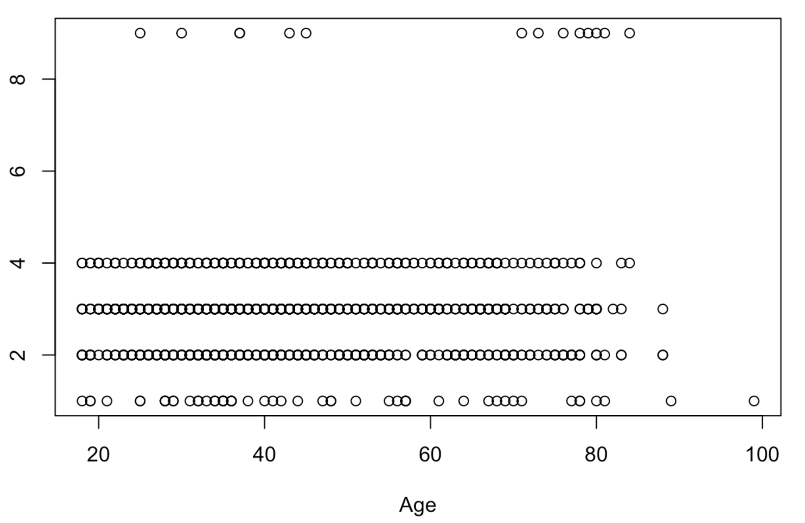
Descriptive stat: Most people who don’t succeed are lazy
1~4 = Strongly agree ~ Strongly disagree9 = refuse to answer

Slide 12
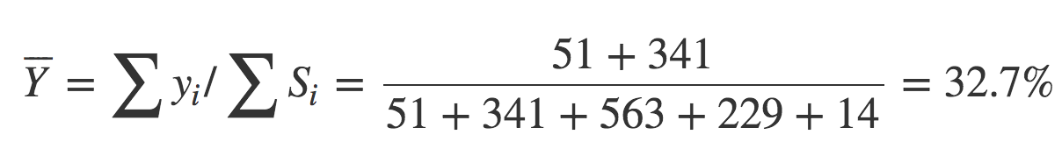
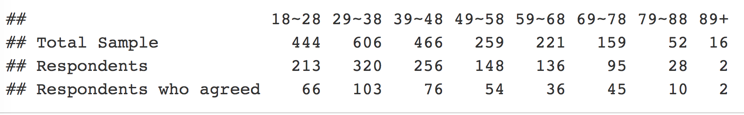
Pre and Post Weighting
Pre-weighting:

Slide 13
Key Takeaway:
Never trust volunteer sampling (ever)
All good survey uses callback: easiest but tedious
used for identification
Weighting is intuitive, but requires “information” before sampling

Slide 14
References
http://sda.berkeley.edu/D3/Natlrace/Doc/nrac.htm
http://sda.berkeley.edu/archive.htm
2004 Jan Wang “Non-response in the Norwegian Business Tendency Survey”
1984 Roderick Little “Survey Nonresponse bias”
2001, Carlson and Williams, “A COMPARISON OF TWO METHODS TO ADJUST WEIGHTS FOR NON-RESPONSE: PROPENSITY MODELING AND WEIGHTING CLASS ADJUSTMENTS”
Lohr. “Sampling: Design and analysis” 2nd edition
http://www.trchome.com/research-knowledge/white-paper-library/227-situational-use-of-data-weighting-complete
http://www.trchome.com/65-market-research-knowledge/white-paper-library/215-non-response-bias-in-survey-sampling-complete
Jennings lecture notes (7,8,10) for Stat 522 at Purdue

